Slide 1
National Schools Twenty20 competition
Finals day Sunday June 30th 2019
Arundel Castle cricket ground

Slide 2
Photographs
by
Patrick Eagar
© No images may be reproduced without permission

Slide 3
The first semi-final
Sedbergh v Millfield
Sedbergh in brown
Millfield in light blue

Slide 4
Johnny Barclay (Arundel, former captain of Sussex CC and former President of MCC) with Andy Whittall, former international cricketer for Zimbabwe, and chairman of the Schools cricket committee

Slide 5
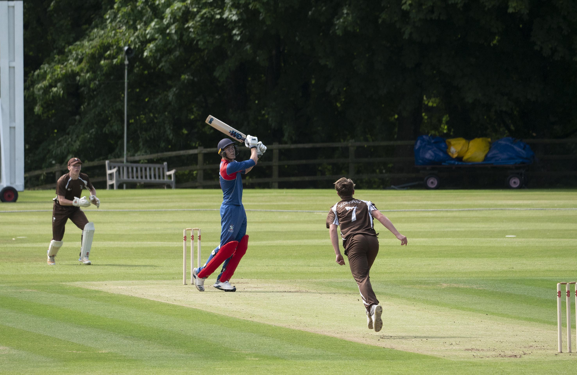
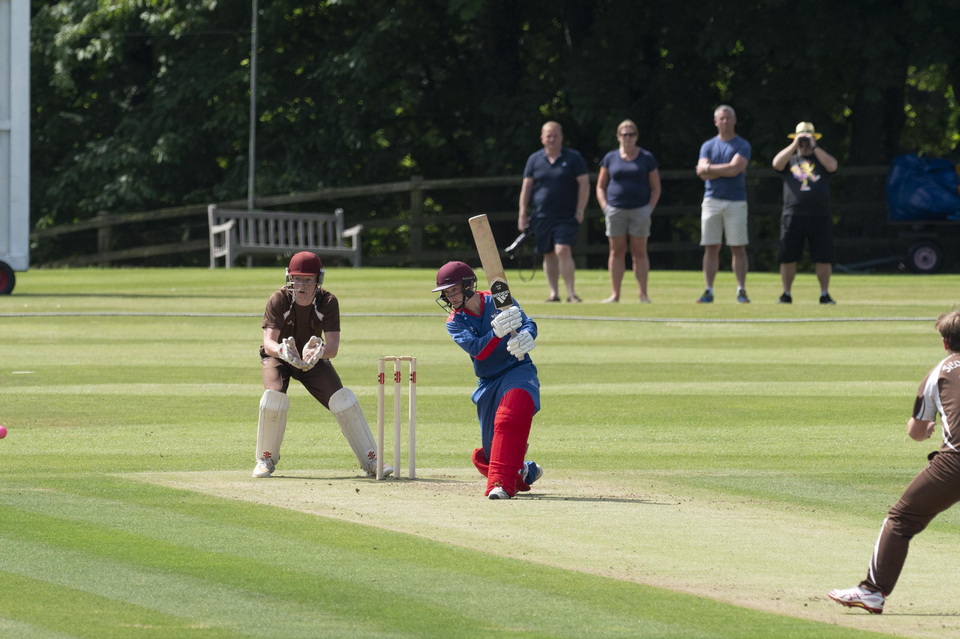
Kasey Aldridge skies Thomas Aspinwall and is about to be caught by George Barnes

Slide 6
Lewis Goldsworthy (Millfield) drives Aspinwall

Slide 7
Christopher Park-Johnson dives and saves runs, Harry Wassell (Millfield) is the batsman
by
by
by
by

Slide 8
Andy McCallum (Millfield) batting, Christopher Park-Johnson is the wicket-keeper

Slide 9
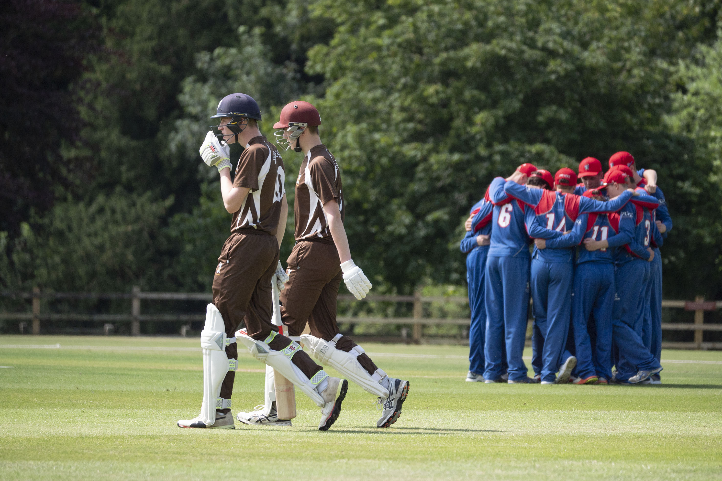
Sedbergh openers take the field while Millfield confer

Slide 10
Ben Davidson drives past Kasey Aldridge

Slide 11
Julius Sumerauer (Millfield) fails to catch George Hill off his own bowling

Slide 12
The second semi-final
Malvern v Merchant Taylors’
Malvern in green
Merchant Taylors’ in black

Slide 13
Malvern v Merchant Taylors'. Robbie Hardwick who made 43.

Slide 14
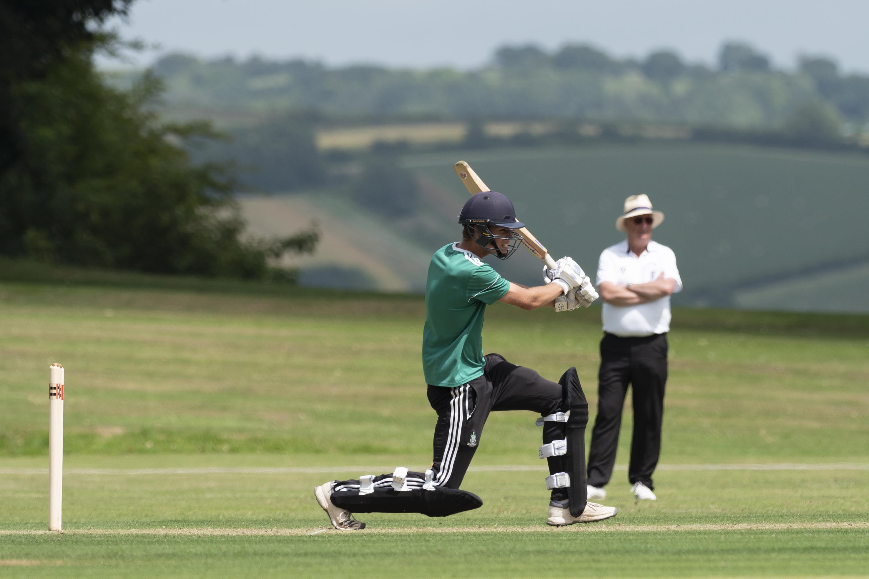
Robbie Hardwick batting

Slide 15
A swarm of bees interrupts play

Slide 16
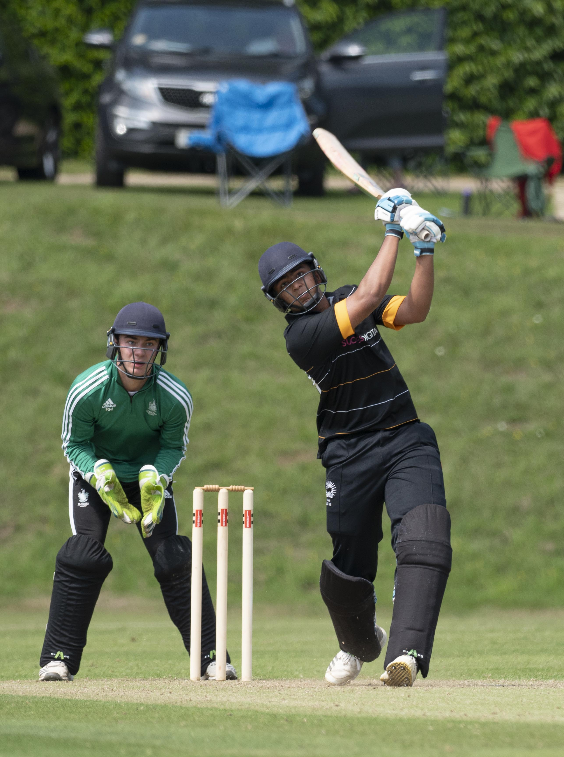
Rohan Day hits a six, but he was run out next ball; Robbie Hardwick is the wicket-keeper.

Slide 17
Rohan Day is run out for 19

Slide 18
David Burnell has a big swing at a ball from Rehaan Edavalath and misses.

Slide 19
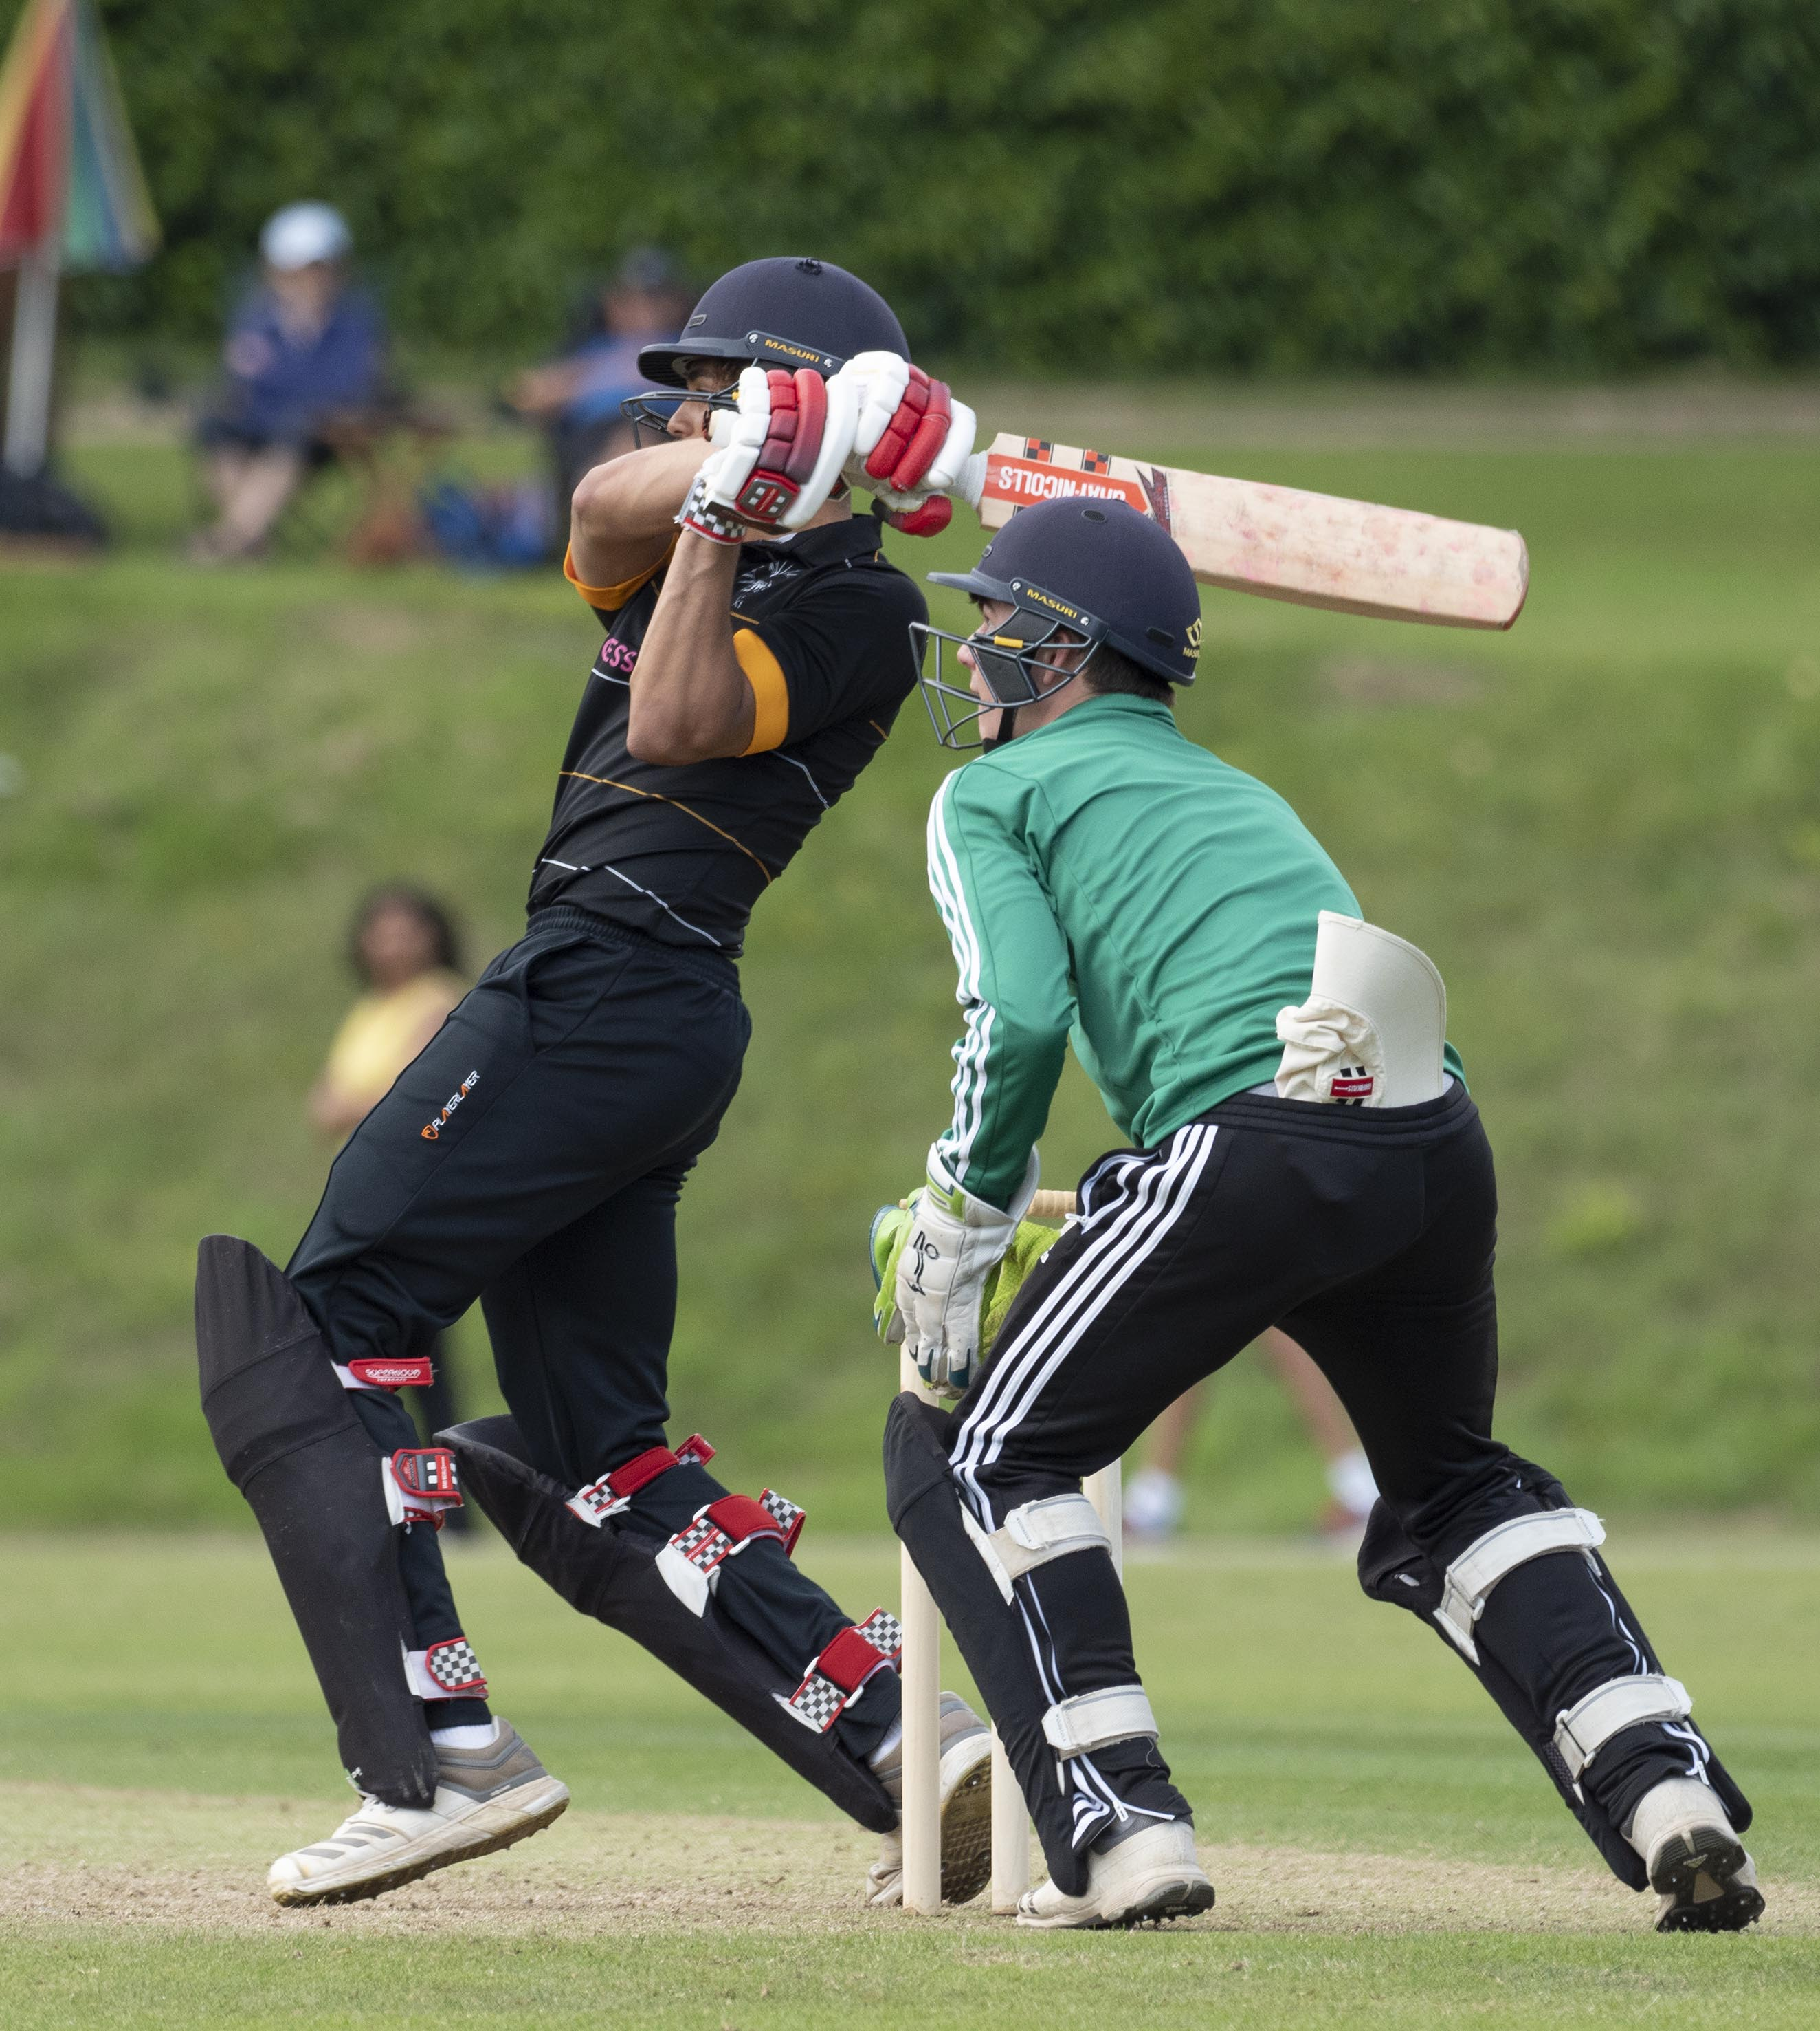
Max John (Merchant Taylors’) batting; he made 43.

Slide 20
Max John is lbw to Aaron Thomson for 43

Slide 21
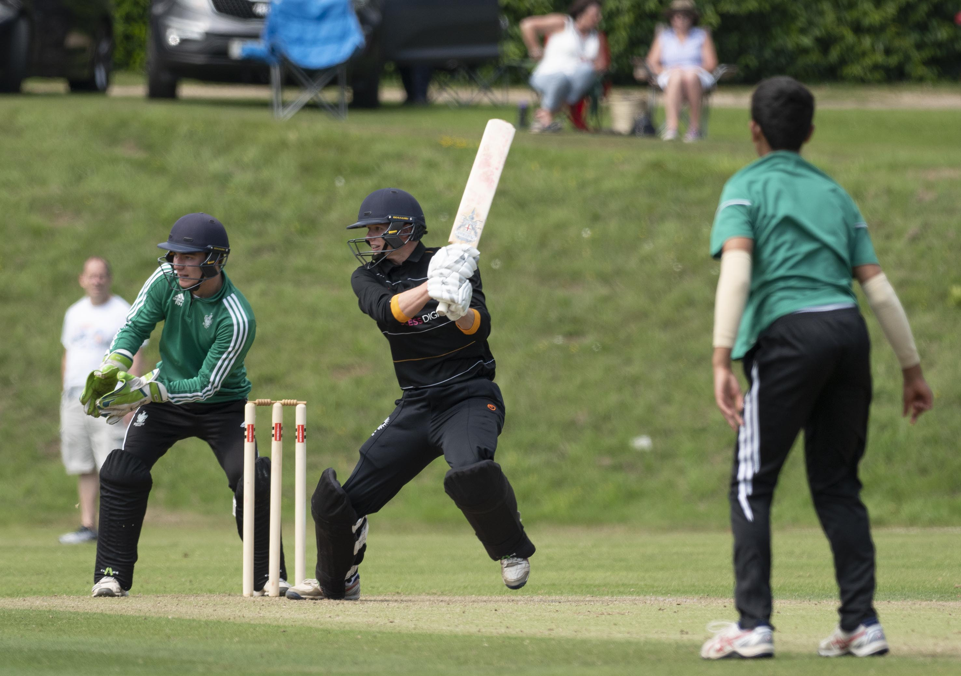
David Burnell batting; he made 33.

Slide 22
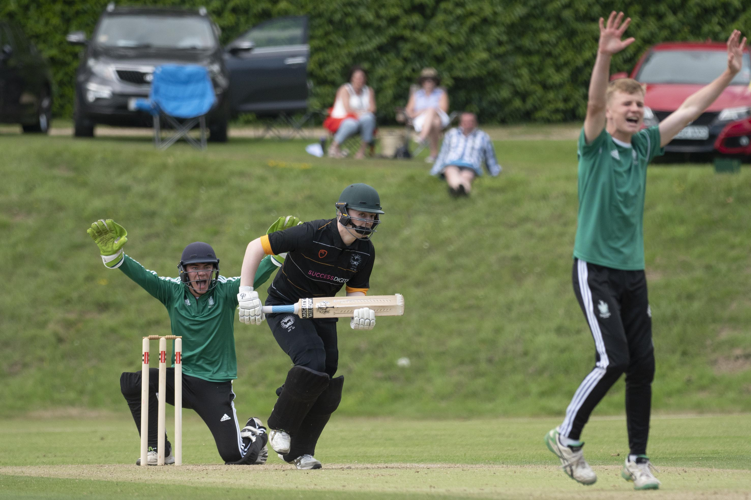
Jack Leathem is lbw to Josh Dickenson for 2

Slide 23
Tom Steene hits a six off Josh Dickenson.

Slide 24
The final
Malvern v Sedbergh
Malvern in green
Sedbergh in brown

Slide 25
George Hill bowling

Slide 26
Thomas Aspinwall (Sedbergh) bowling

Slide 27
Jack Haynes batting during his 49

Slide 28
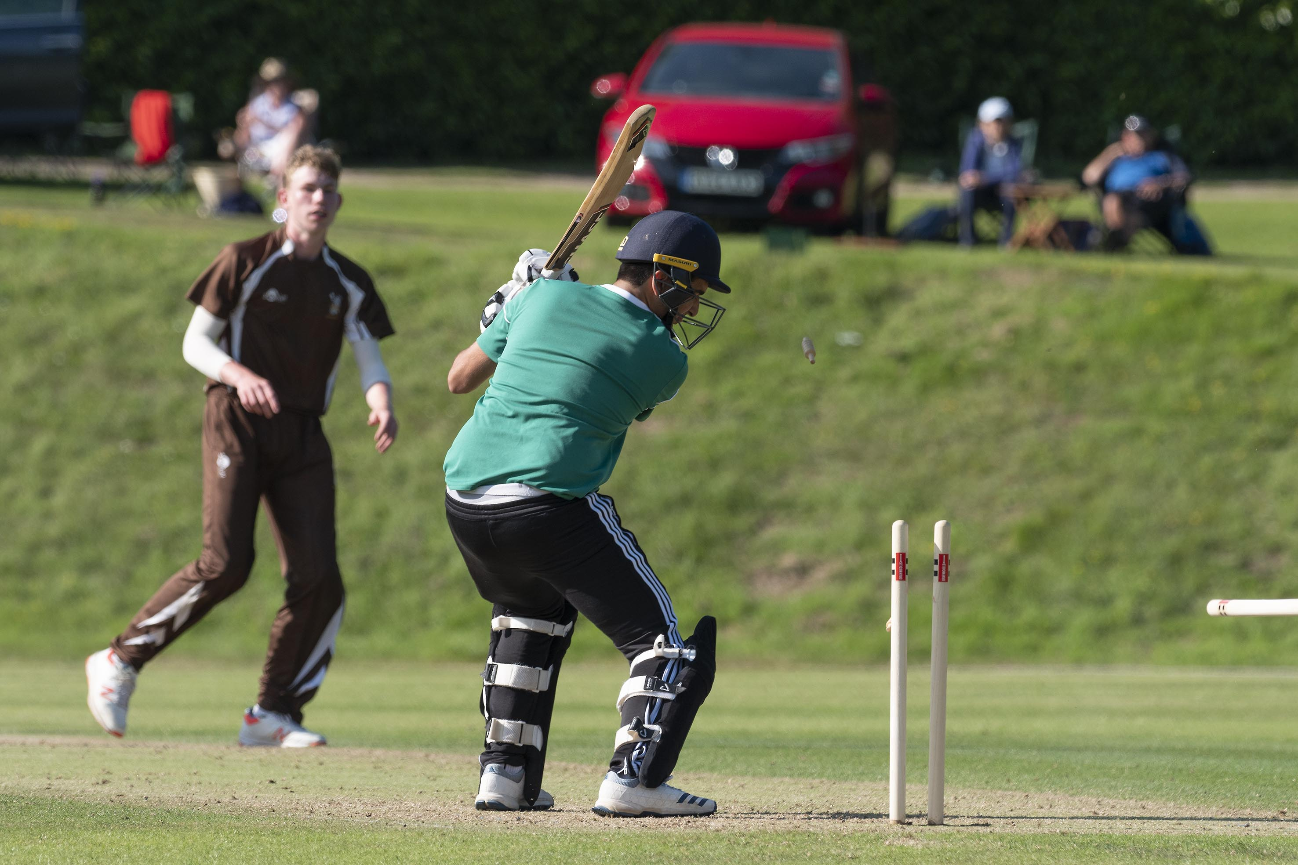
Luke Tulacz is bowled by George Hill for 18

Slide 29
Matty Revis opening the batting for Sedbergh; Robbie Hardwick is the wicket-keeper

Slide 30
Matty Revis batting with the Arundel view in the background

Slide 31
George Hill leaves after being bowled by Ludo Staley for 12

Slide 32
Roman Wheatley is run out.

Slide 33
George Barnes who made 28 not out for Sedbergh

Slide 34
Last man Aiden Little is caught by Robbie Hardwick off Aaron Thomson and Malvern win the 2019 trophy

Slide 35
Malvern celebrate their victory; Aiden Little is the Sedbergh batsman

Slide 36
The presentation
by
Johnny Barclay
Director of cricket at Arundel
Former captain Sussex CCC
Former President of MCC

Slide 37
Johnny Barclay at the presentation

Slide 38
The Malvern captain, Jack Haynes, receives the cup from Johnny Barclay

Slide 39
The Malvern captain, Jack Haynes, receives the cup from Johnny Barclay

Slide 40
Malvern – winners 2019

